Slide 1
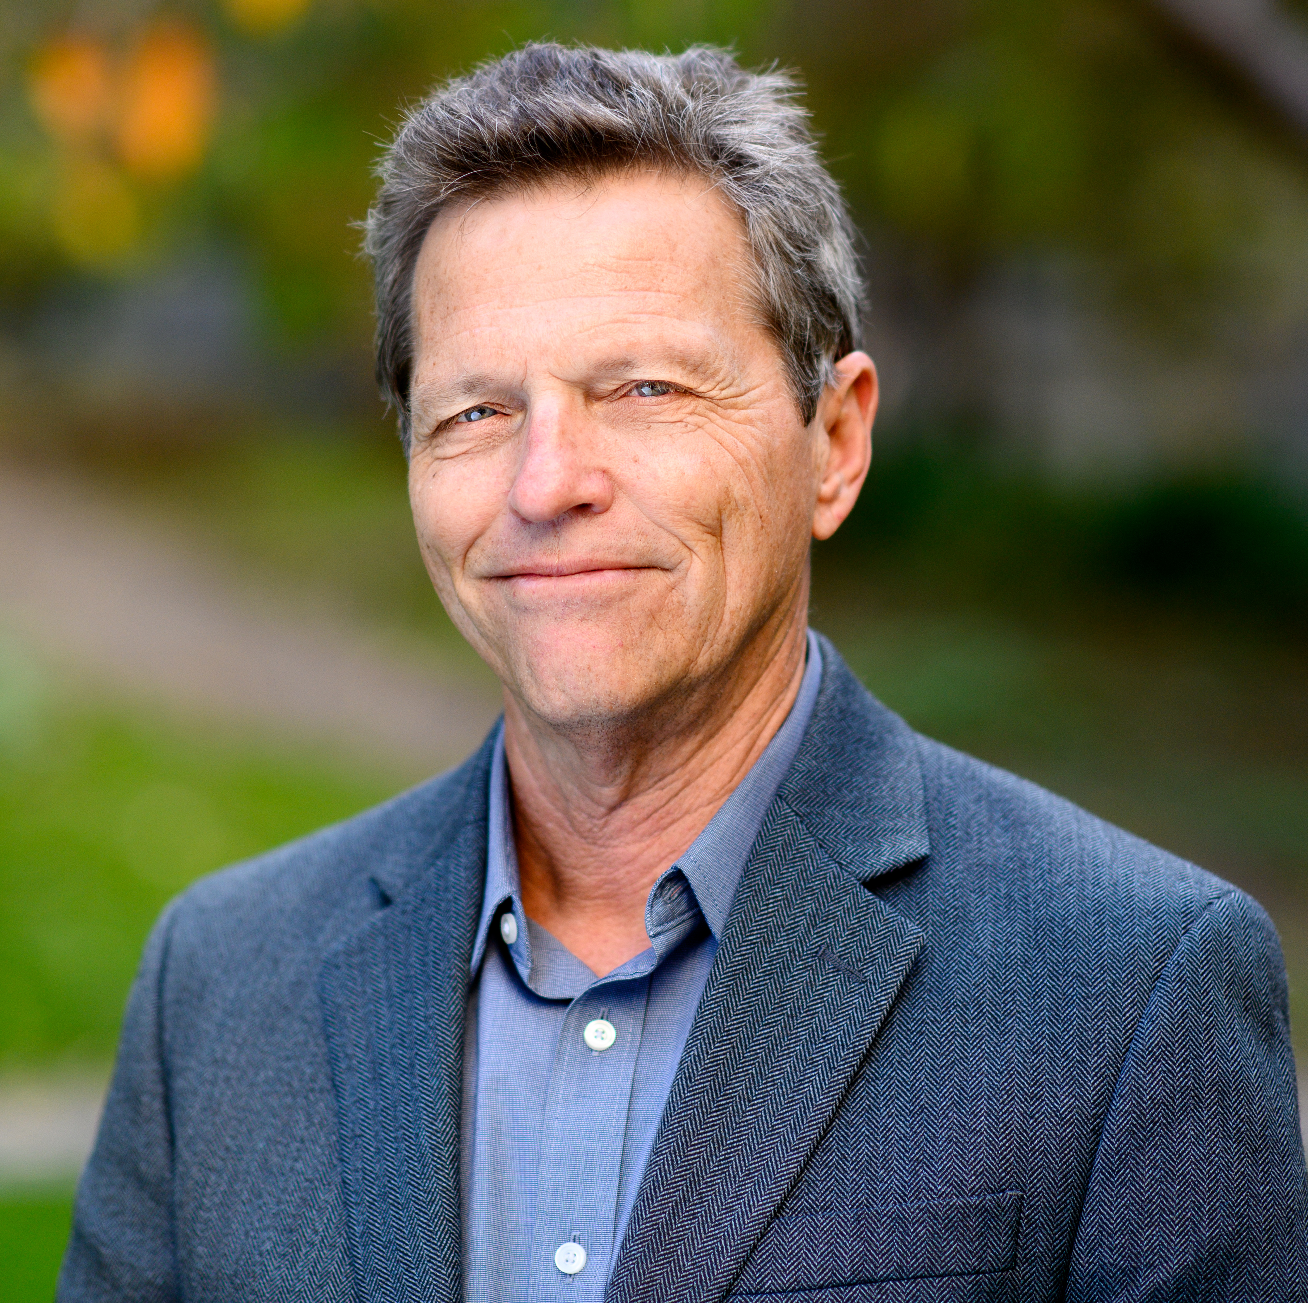
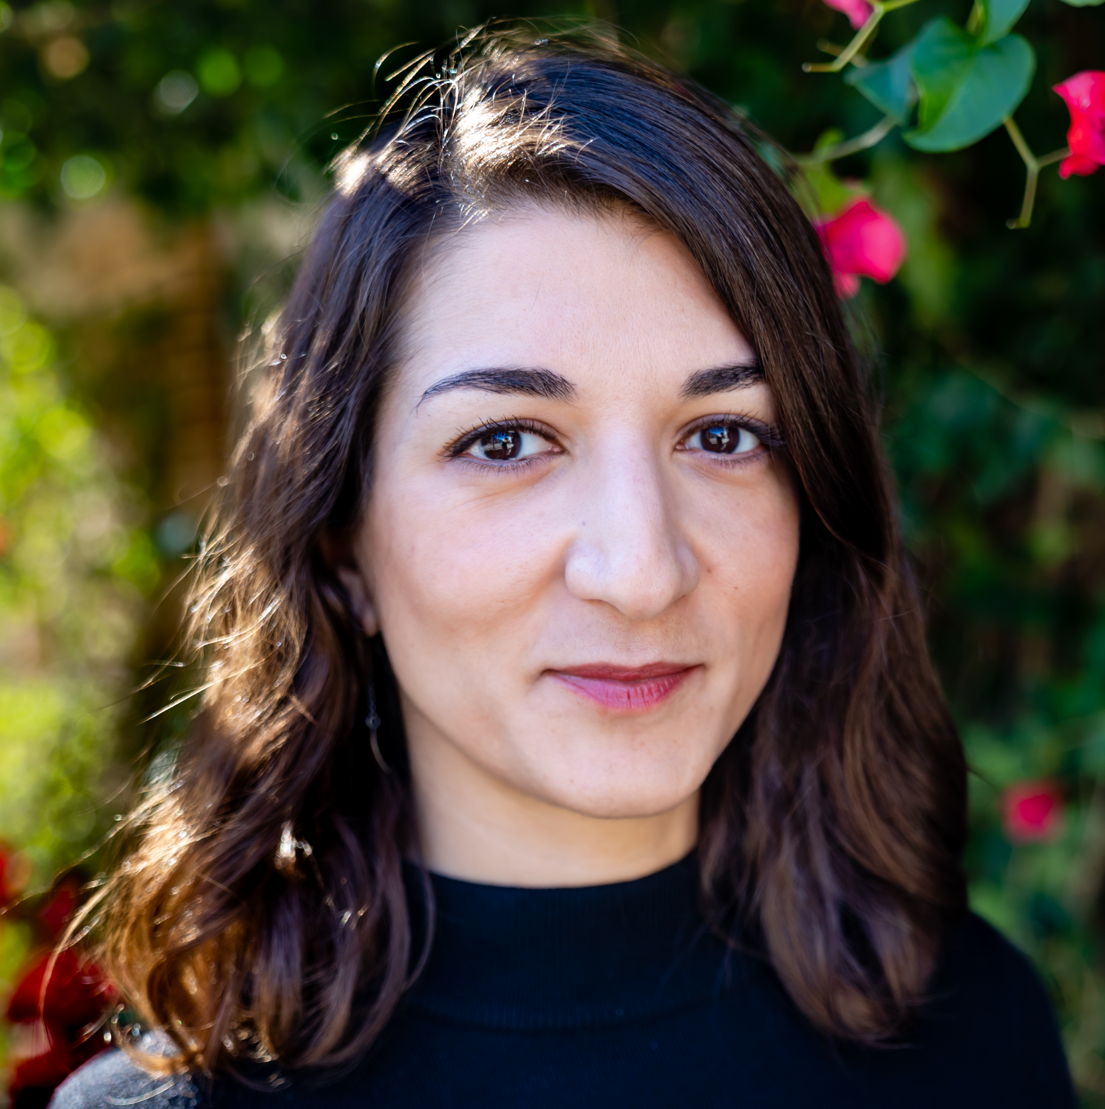
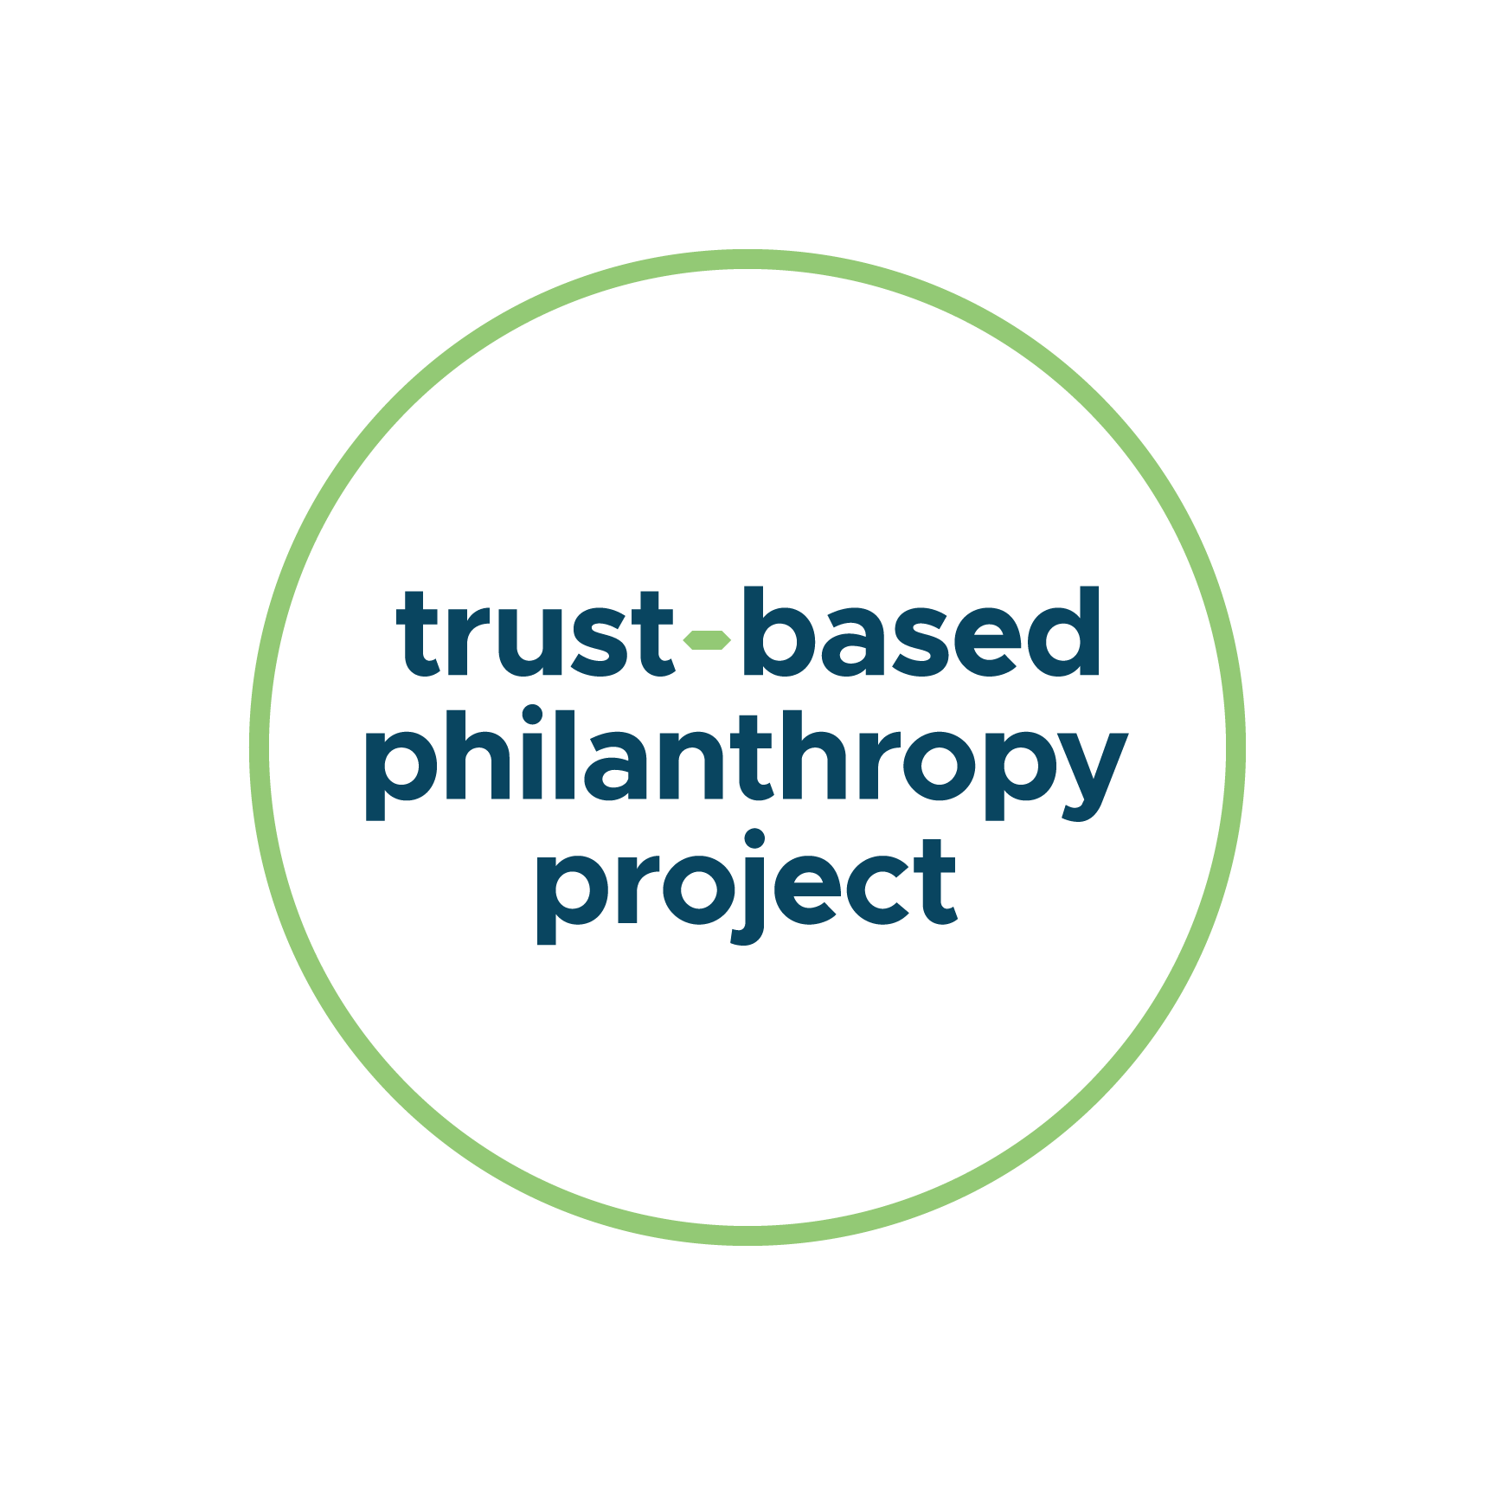
The Power of Trust and Relationships
in Philanthropy
John Esterle
Co-Executive Director
The Whitman Institute
Shaady Salehi
Director
Trust-Based Philanthropy Project

Slide 2
The Problem:
A Values to Practice Gap in Philanthropy

Slide 3
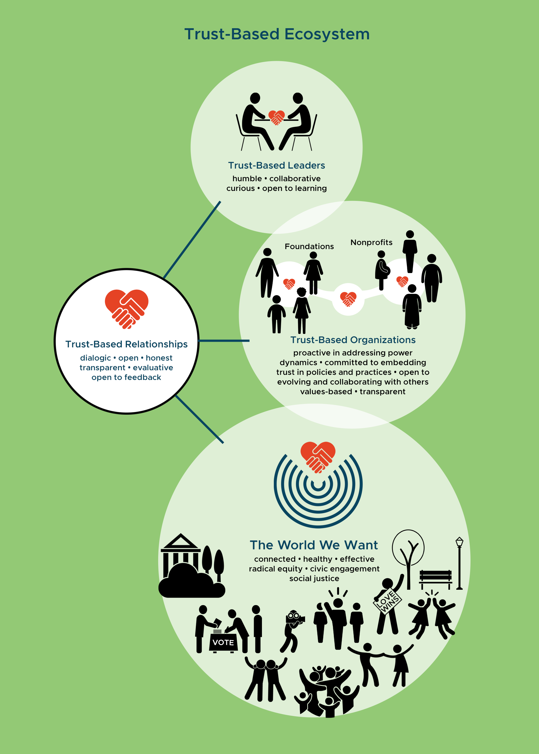
A Values-Based Approach
Power-Sharing
Equity
Humility
Transparency
Curiosity
Collaboration

Slide 4
6 Principles of Trust-Based Philanthropy
1
Give Multi-Year Unrestricted Funding
Do the Homework
Simplify & Streamline Paperwork
Be Transparent & Responsive
Solicit & Act on Feedback
Offer Support Beyond the Check
2
3
4
5
6

Slide 5
Key Takeaways
At its core, trust-based philanthropy is about trusting the expertise, knowledge, and decision-making of nonprofit leaders
This is not just about what you do in policy and practice, but how you show up
Shifting power dynamics and alleviating burdens on nonprofits benefits funders too
Trust-based philanthropy is a journey not a checklist
www.trustbasedphilanthropy.org

Slide 6
Steps You Can Take Right Now
Download Trust-Based Philanthropy resources at www.trustbasedphilanthropy.org/resources
Identify one concrete way that you can shift your behavior or practice to be more trust-based
Fill out the follow-up survey
Contact hello@trustbasedphilanthropy.org with specific questions about adopting TBP
www.trustbasedphilanthropy.org

